Slide 1
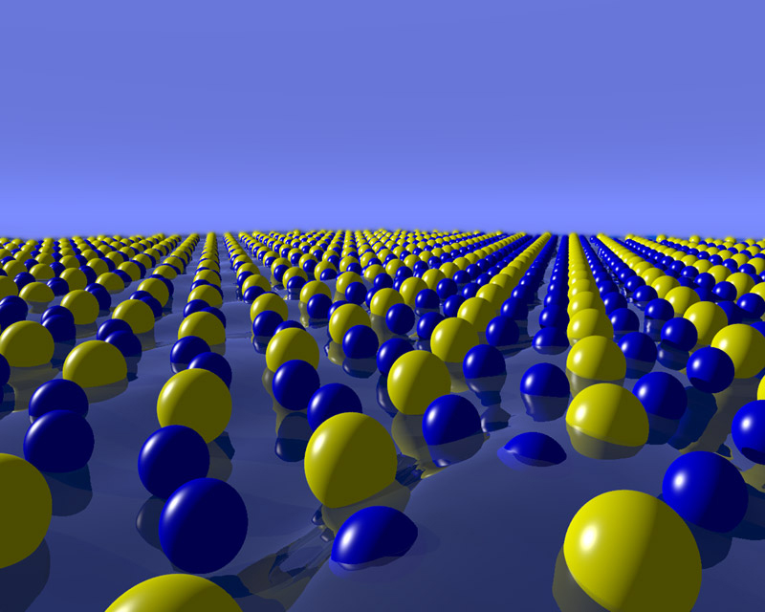
Lattice Dynamics Plays an important role for anything not at low temperature – like most things on Earth
Notes:
In past, class ran a little short and is pretty math heavy. Maybe break up with fire eating demo? Recently added second velocity discussion so that may eat up the remaining extra time.

Slide 2
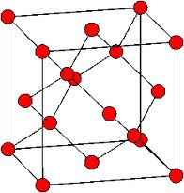
Objectives
By the end of today you should be able to:
Apply the equations of motion to 1D systems with one or more atoms in the basis
Expand 1D model into 2 and 3 dimensions
Analyze the dispersion curves for real crystals

Slide 3
λ> interatomic spacing
continuum approach fails
Notes:
It is only by considering these quantized phonons that we can finally get an accurate calculation for specific heat (which we will discuss more after a few classes)

Slide 4
λ> interatomic spacing
continuum approach fails
vibrational modes quantized
phonons
Notes:
It is only by considering these quantized phonons that we can finally get an accurate calculation for specific heat (which we will discuss more after a few classes)

Slide 5
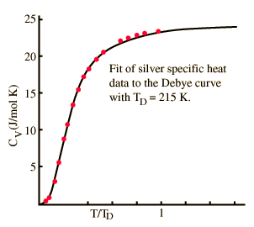
λ> interatomic spacing
continuum approach fails
vibrational modes quantized
phonons
Phonons are responsible for the majority of the thermal capacity of solids (a later lecture).
Also important for electrical conductivity
Notes:
It is only by considering these quantized phonons that we can finally get an accurate calculation for specific heat (which we will discuss more after a few classes)

Slide 6
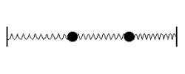
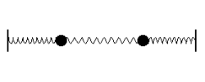
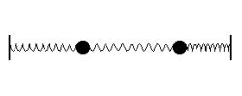
Vibrational Modes of a Monatomic Lattice
Linear chain:
Remember: two coupled harmonic oscillators
Symmetric mode
Anti-symmetric mode
Superposition of normal modes
When you have two masses, you have two modes.
But, we have lots of atoms in our crystal!
Start with 1D

Slide 7
generalization
Infinite linear chain
?
How to derive the equation of motion in the harmonic approximation
n-2
n-1
n
n+1
n+2
C
a
u_{n-2}
u_{n-1}
u_{n}
u_{n+1}
u_{n+2}
u_{n-2}
u_{n-1}
u_{n}
u_{n+1}
u_{n+2}
fixed

Slide 8
generalization
Infinite linear chain
?
How to derive the equation of motion in the harmonic approximation
n-2
n-1
n
n+1
n+2
C
a
u_{n-2}
u_{n-1}
u_{n}
u_{n+1}
u_{n+2}
u_{n-2}
u_{n-1}
u_{n}
u_{n+1}
u_{n+2}
fixed

Slide 9
generalization
Infinite linear chain
?
How to derive the equation of motion in the harmonic approximation
n-2
n-1
n
n+1
n+2
C
a
u_{n-2}
u_{n-1}
u_{n}
u_{n+1}
u_{n+2}
u_{n-2}
u_{n-1}
u_{n}
u_{n+1}
u_{n+2}
fixed

Slide 10
generalization
Infinite linear chain
?
How to derive the equation of motion in the harmonic approximation
n-2
n-1
n
n+1
n+2
C
a
u_{n-2}
u_{n-1}
u_{n}
u_{n+1}
u_{n+2}
u_{n-2}
u_{n-1}
u_{n}
u_{n+1}
u_{n+2}
fixed

Slide 11
Total force driving atom n back to equilibrium
n
n

Slide 12
Total force driving atom n back to equilibrium
n
n
equation of motion

Slide 13
Total force driving atom n back to equilibrium
n
n
equation of motion
Old solution for continuous wave equation was . Use similar?

Slide 14
Total force driving atom n back to equilibrium
n
n
equation of motion
Old solution for continuous wave equation was . Use similar?
?
approach for linear chain
Let us try!

Slide 15
Total force driving atom n back to equilibrium
n
n
equation of motion
Old solution for continuous wave equation was . Use similar?
?
approach for linear chain
Let us try!

Slide 16
Total force driving atom n back to equilibrium
n
n
equation of motion
Old solution for continuous wave equation was . Use similar?
?
approach for linear chain
Let us try!
,

Slide 17
Total force driving atom n back to equilibrium
n
n
equation of motion
Old solution for continuous wave equation was . Use similar?
?
approach for linear chain
Let us try!
,
,

Slide 18
Total force driving atom n back to equilibrium
n
n
equation of motion
Old solution for continuous wave equation was . Use similar?
?
approach for linear chain
Let us try!
,
,

Slide 19
Total force driving atom n back to equilibrium
n
n
equation of motion
Old solution for continuous wave equation was . Use similar?
?
approach for linear chain
Let us try!
,
,

Slide 20
Total force driving atom n back to equilibrium
n
n
equation of motion
Old solution for continuous wave equation was . Use similar?
?
approach for linear chain
Let us try!
,
,

Slide 21
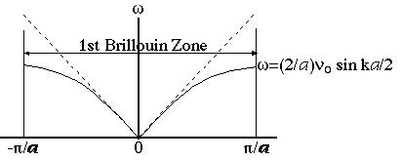
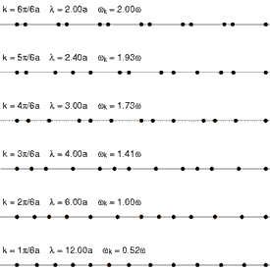
Note: here pictures of transversal waves
although calculation for the longitudinal case
k
Continuum limit of acoustic waves:

Slide 22
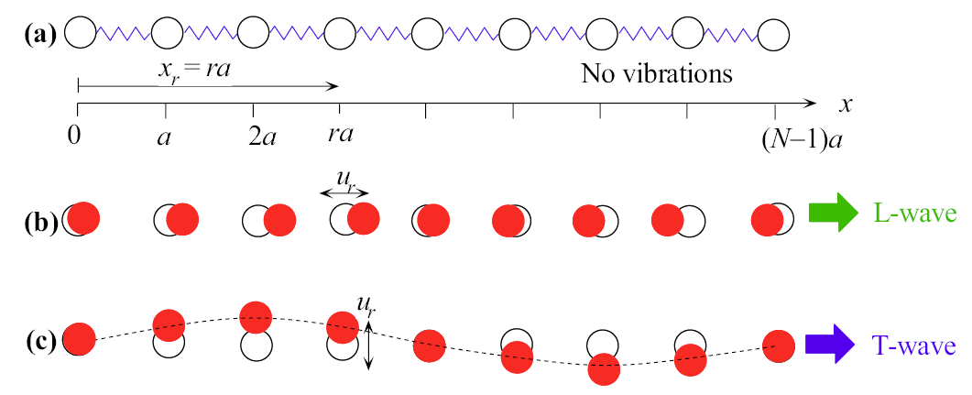
Technically, only have longitudinal modes in 1D
(but transverse easier to see what’s happening)
x = na
u_{n}
u_{n}
(a) Chain of atoms in the absence of vibrations.
Notes:
Will need to trim out some of this but wait until see how much we get through in prior lecture

Slide 23
Technically, only have longitudinal modes in 1D
(but transverse easier to see what’s happening)
x = na
u_{n}
u_{n}
(a) Chain of atoms in the absence of vibrations.
(c) A transverse (T) wave traveling along x. Atomic displacements (u_{n}) are perpendicular to the x axis.
(b) and (c) are snapshots at one instant.
Notes:
Will need to trim out some of this but wait until see how much we get through in prior lecture

Slide 24
Technically, only have longitudinal modes in 1D
(but transverse easier to see what’s happening)
x = na
u_{n}
u_{n}
(a) Chain of atoms in the absence of vibrations.
(b) Coupled atomic vibrations generate a traveling longitudinal (L) wave along x. Atomic displacements (u_{n}) are parallel to x.
(c) A transverse (T) wave traveling along x. Atomic displacements (u_{n}) are perpendicular to the x axis.
(b) and (c) are snapshots at one instant.
Notes:
Will need to trim out some of this but wait until see how much we get through in prior lecture

Slide 25
Slope at boundary?
Results in same motion of the atoms
Arbitrary origin
k
What was the slope equal to for low k?
, here h=1
1-dim. reciprocal
lattice vector
Same as before!
Region
is called
Means we only have to consider a small range of k values rather than all possible wavelengths!
first Brillouin zone
Notes:
Repeats because the origin is arbitrary.
I improved this a bit. Did the class flow better in this section this time?
At low k, slope is sound velocity, propagation speed of phonons. What does it mean that it goes to zero at boundary?

Slide 26
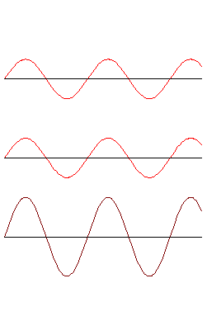
What is going on at the edge of the Brillouin zone?
k
Equivalent to a Bragg reflection of x-rays.
When the Bragg condition is satisfied, the wave does not travel but reflects back and forth forming a standing wave.
Notes:
What if you subtracted the waves?

Slide 27
What if we had more than nearest neighbor interactions?
?
How to derive the equation of motion in the harmonic approximation
n-2
n-1
n
n+1
n+2
C
a
u_{n-2}
u_{n-1}
u_{n}
u_{n+1}
u_{n+2}
u_{n-2}
u_{n-1}
u_{n}
u_{n+1}
u_{n+2}
fixed
Notes:
Metals can have interactions as far away as 20th nearest neighbors! Remember that metals aren’t very localized unlike covalent and ionic systems.
Same solution should be fine.

